Slide 1
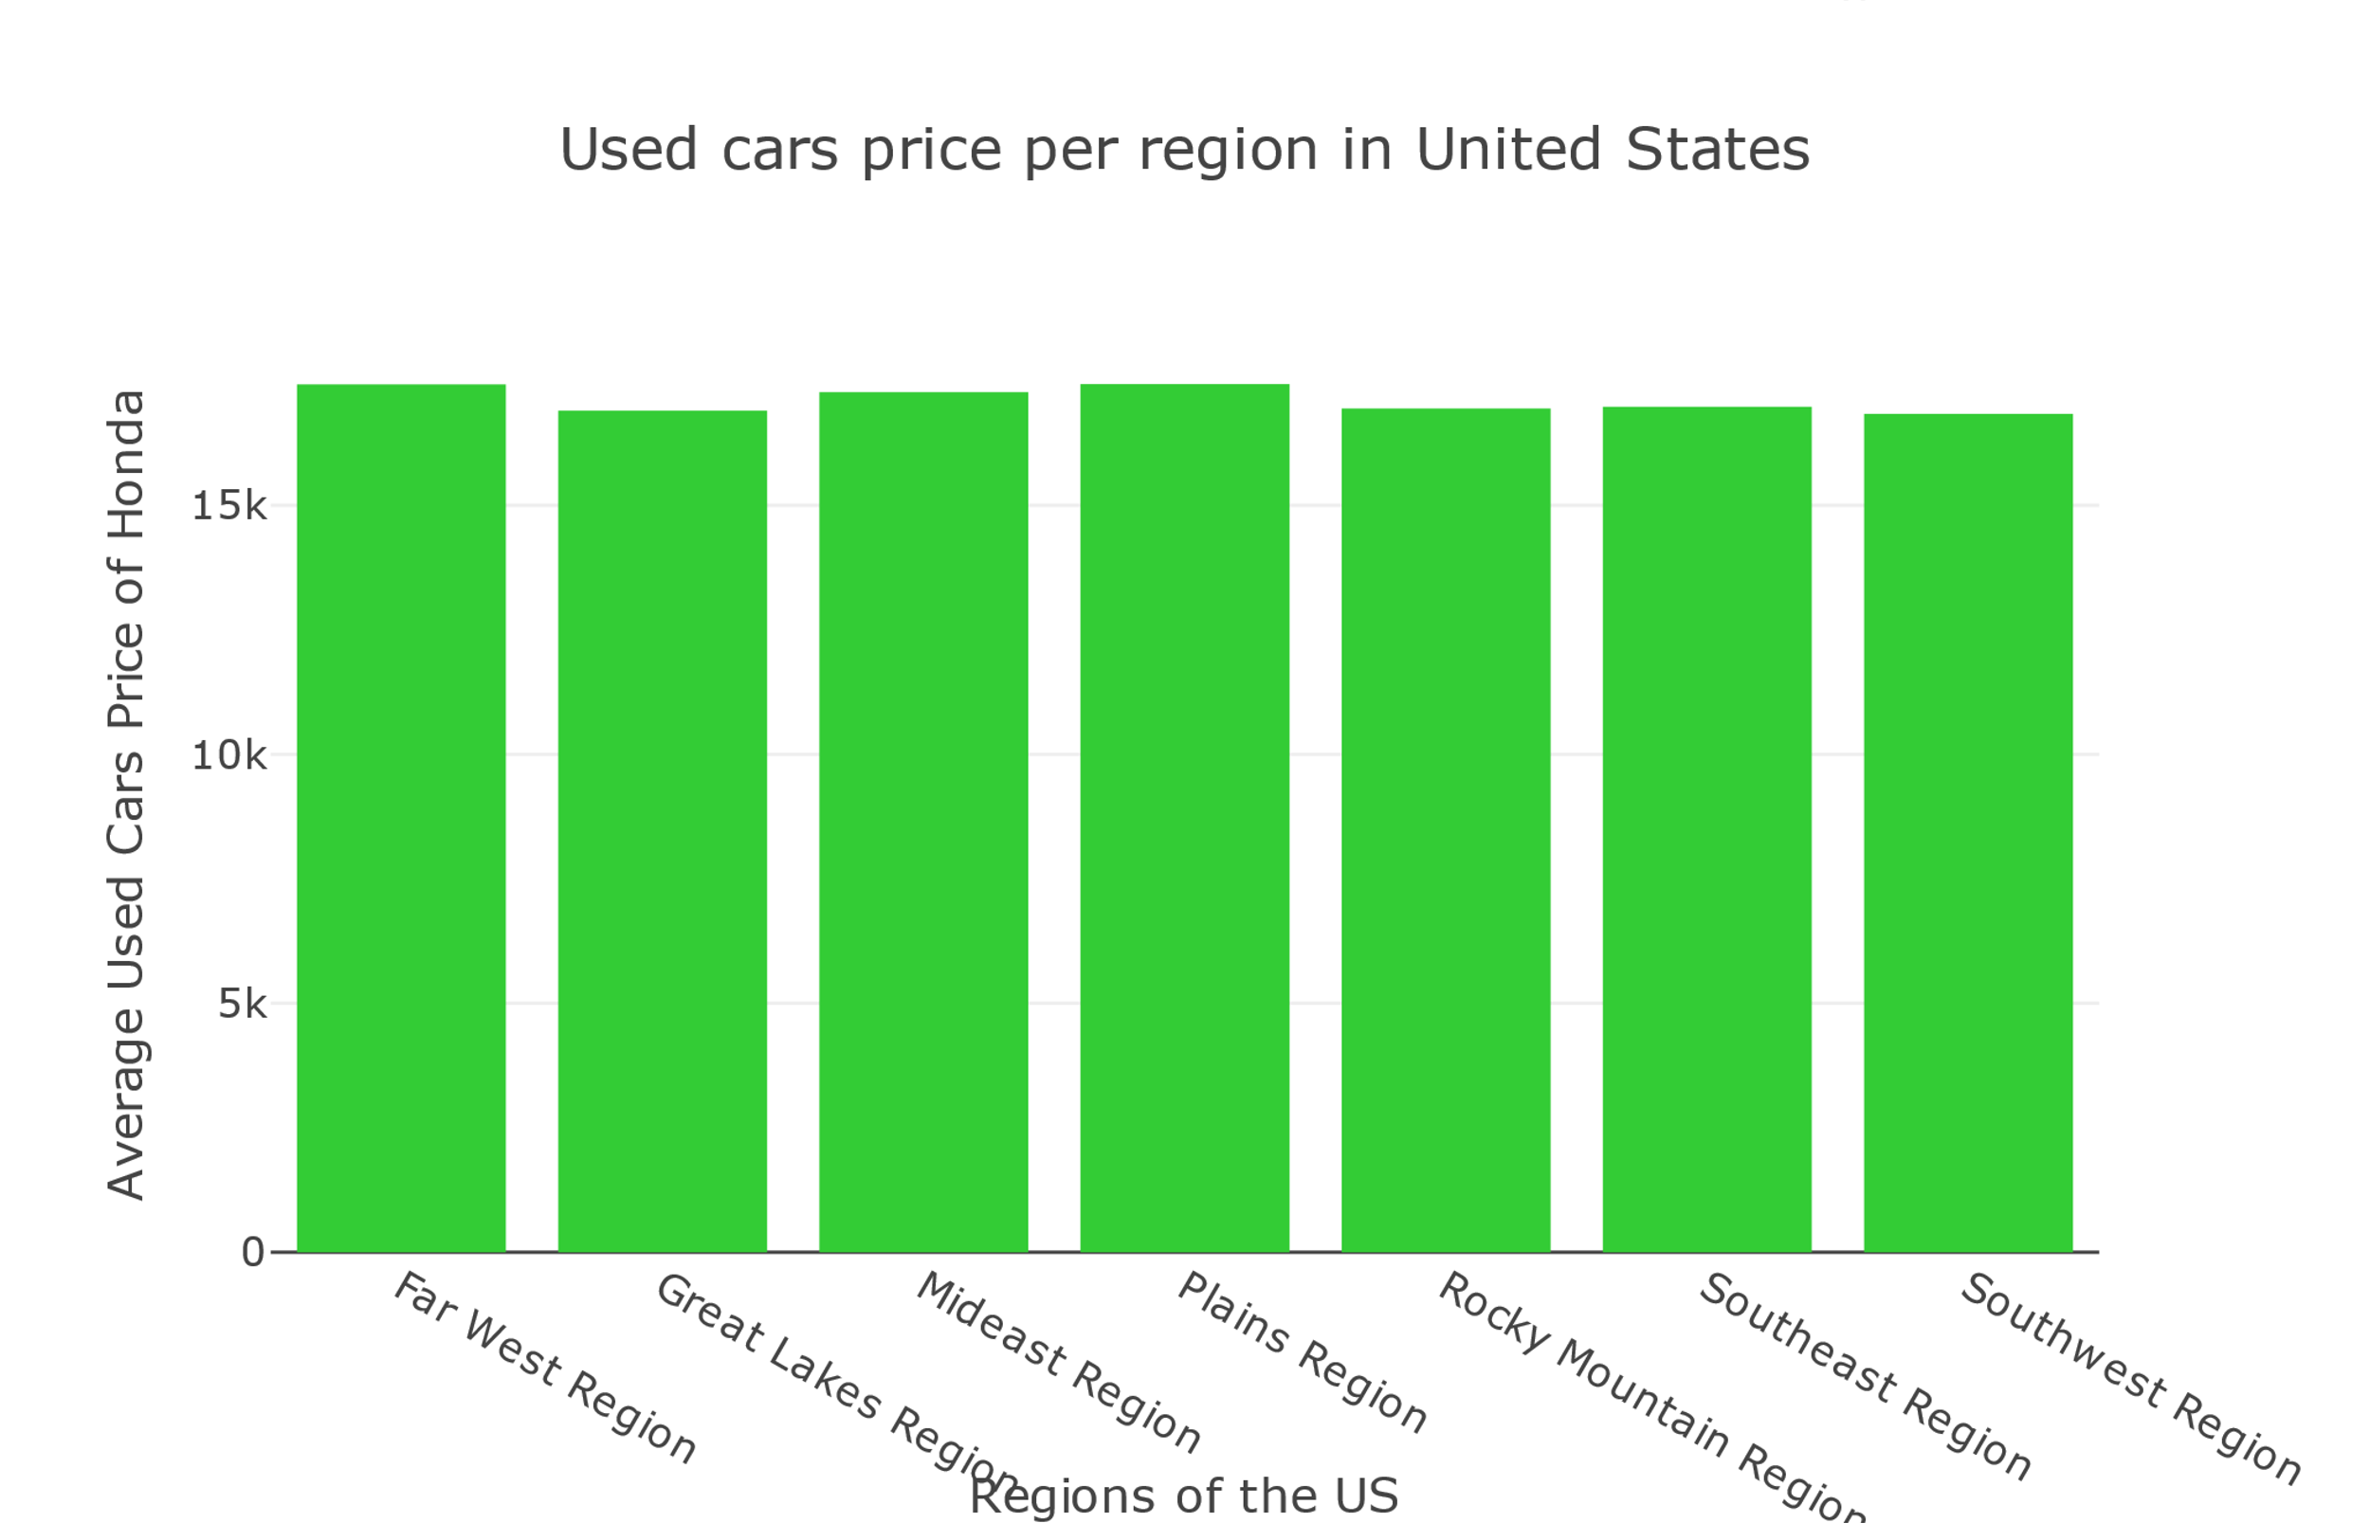
Car Analyzer Dashboard
Notes:
When compared across the US, used cars price was almost the same for each model.
After all the numbers was crushed and we after we try various models and feature tuning, no one region saw a significant change in price for each used vehicle model

Slide 2
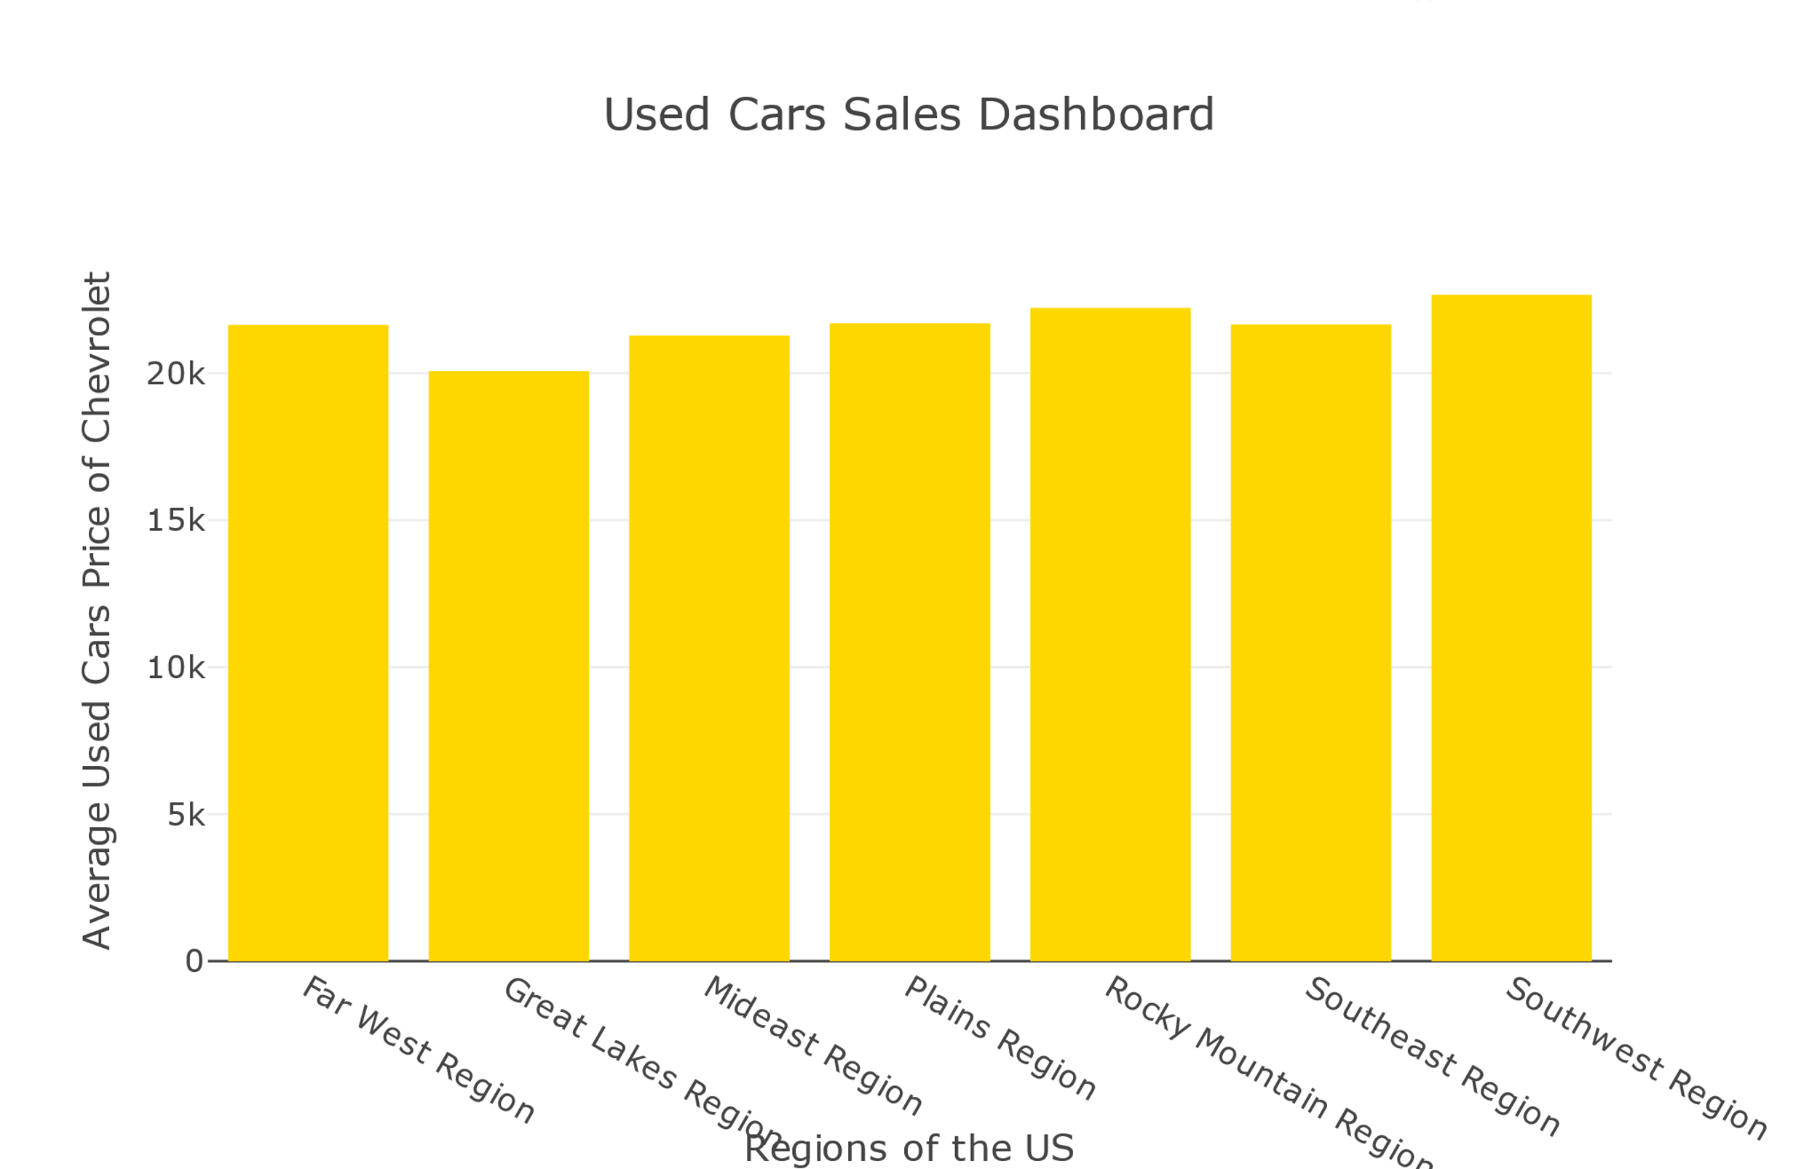
Car Analyzer Dashboard
Notes:
The codes were ran on another vehicle model (Chevrolet), and the number did not changed.

